Slide 1
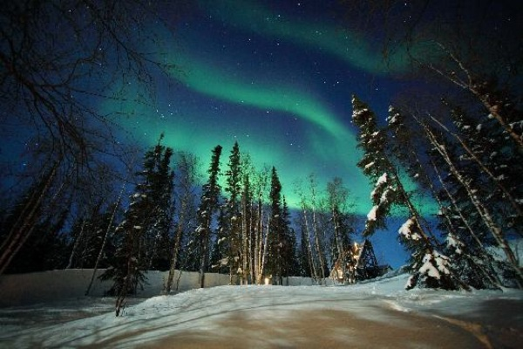
Education in the NWT
Welcome to the adventure!

Slide 2
The lay of the land
The NWT is comprised of 33 communities:
  3 Regional Centers – Inuvik, Fort Smith & Hay River (average 3,200 residents)
  Yellowknife, the capital, with ±20,000 residents
  29 small communities (average 485 residents)
Notes:
33 communities
How many of you will be in Ft. Smith, Hay River or Inuvik? Regional Centres count a couple thousand people
How about here in Yellowknife?
That means the rest of you will be in one of our many small communities...

Slide 3
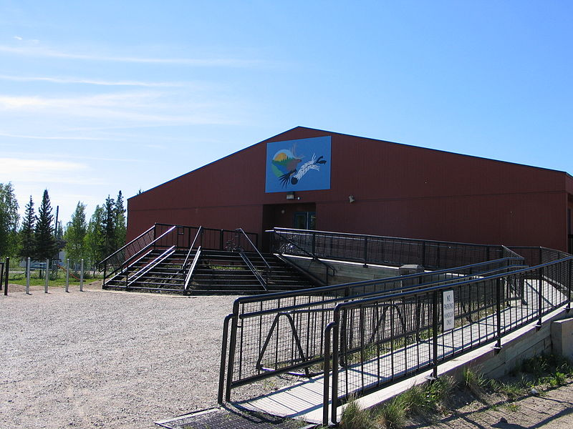
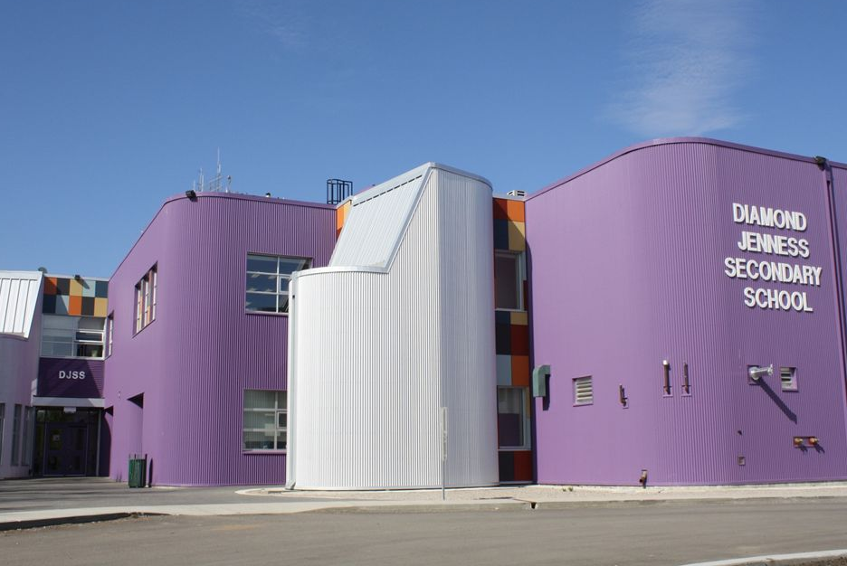
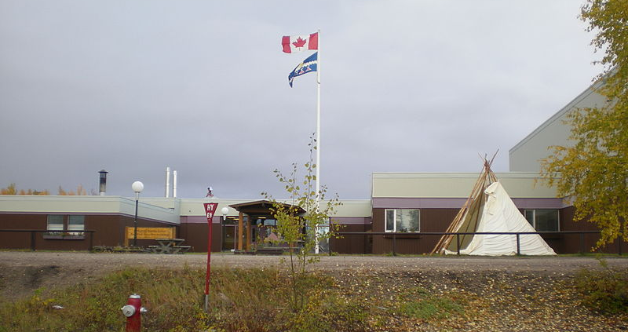
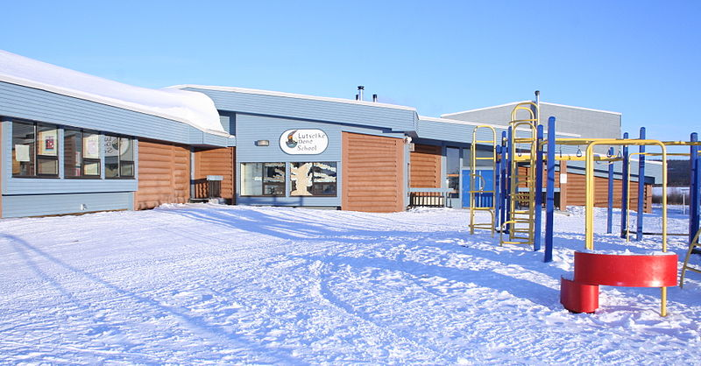
Our schools
There are 49 schools across the Territory.
  Ranging in size from ±600 students to ±4 students
  Majority are pre-K to grade 12 schools
  9 schools offer French immersion
  3 schools offer Aboriginal Language immersion programs at certain grade levels
  2 schools are French First Language schools
Notes:
There are 49 schools across the Territory
Ranging in size from ±600 students (Yellowknife high school) to ±4 students (Kakisa)
How many of you, when you were students, went to a school of 600+ students? 1000+ students? 2000+ students?
How many of you went to a school of fewer than 150 students?
That will be the reality this year for many of you.
The majority of our schools are the only school in the community = prek-12 schools, usually with two or three split-grade levels in the same classroom
9 schools offer French immersion
3 schools offer Aboriginal language immersion at certain grade levels
2 schools are French First Language schools – in Yellowknife and Hay River

Slide 4
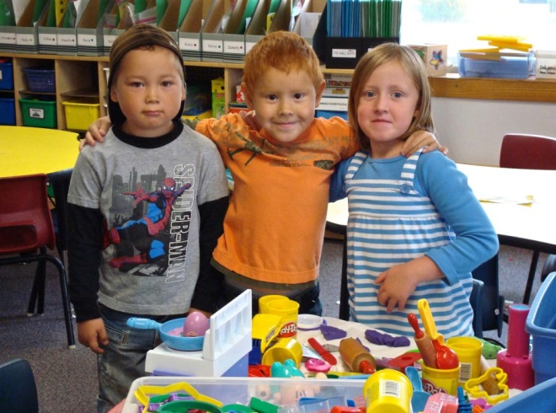
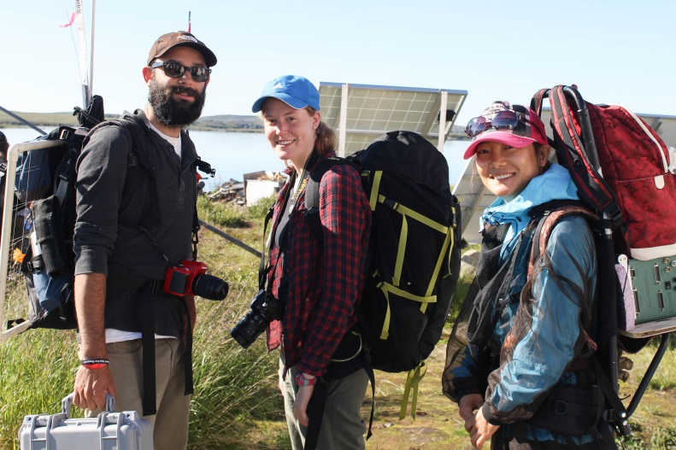
Our Students and Educators
±8500 students across the entire NWT
65% of Aboriginal descent, representing the
9 official Aboriginal languages of the Territory
±700 educators in our schools
    approximately 85% which come from elsewhere in the world, mostly from Canadian provinces
Notes:
Our students & educators
±8500 students – about 65% of which are of Aboriginal descent… 9 official Aboriginal languages…11 official languages in total
This land we share was first inhabited by many different Aboriginal peoples (the Dene, Inuvialuit, Gwichin…).
Their teachings, world views, language and cultures continue to be central to our communities and schools.
±700 teachers & principals – of which about 85% come from elsewhere in Canada or other places in the world
How many of you are from Western Canada (AB, BC)?
From the Prairies (SK, MB)?
From Ontario or Quebec?
From the eastern provinces or Maritimes?
How about from outside of Canada? If so…Where are you from?

Slide 5
Our Political Landscape
Territorial Government
Aboriginal Governments
Consensus system
19 MLAs
Speaker, 7 Cabinet Members, 11 Regular Members
Transparency not seen in provincial governments
Many have modern land, resources & self-government agreements (regional & community)
Others are continuing to negotiate
Often regional and community level organization
Municipal/Local Governments
Similar to rest of Canada
In some communities, Aboriginal Governments provide municipal services
1 Federal Member of Parliament
1 Senator
Notes:
Our Political Landscape
Territorial Government - Consensus
Hallmark of politics in the Northwest Territories is that it operates as under a consensus government system. Candidates for election to the territorial legislature do not stand as members of a political party; they are elected as independents. The 19 Members of the Legislative Assembly (or MLAs) elected first select the Speaker of the House and then the Premier by way of a secret ballot, rather than on the basis of party affiliation. The Premier then selects from the MLAs six Ministers to form his/her Cabinet and gives them the different portfolios.
The eleven MLAs who are not in Cabinet are referred to as “regular members” and form a sort of unofficial opposition responsible for holding the government accountable and responsive to the people of the NWT.
The eleven regular members hold the balance of power. Cabinet cannot ignore the majority. However, consensus government DOES NOT mean that decisions must be unanimous for motions to pass and legislation to be
enacted. A majority vote wins.
Difference b/w provinces and territories
The two major differences between the legislative powers of Territories and that of provinces are the power of the provinces to amend their constitutions and control the management and sale of public lands.
Significance of Devolution
Should the Northwest Territories wish to pursue provincial status, it will be necessary to amend the Constitution of Canada. This will require consent of the Parliament of Canada and a double majority from the provinces - seven of ten provinces with at least 50 percent of the population of Canada
Municipal/Local Government
Aboriginal Government

Slide 6
The Educational Context
~ System of education past & present
Education has always been a priority.
    Duty of entire community
    Elders as teachers
    1800s - Formal education system came through missionaries
    * History of Residential Schooling
    1980s - School boards established
    1990s - District Education Authorities (DEA) established at the community level and District Education Councils (DECs)
    at the regional levels
Notes:
Education has always been a priority for northern people. One of the first duties of any community was to help their children become capable people. Elders were central to teaching, as they helped children learn knowledge, skills, attitudes, and values that they, and their community, would need in order to survive.
1800s
A different way of teaching children was brought to the North in the 1800’s when missionaries arrived and began to teach, in French or English, with a focus on religious instruction. This Euro-Canadian style of teaching became formalized through the creation of residential schools…which you will learn a great deal about tomorrow.
In the 1970’s, education was a key focus as the NWT was beginning to define itself as a territory.
1980s – Creation of school boards
1990s – District Education Authorities (DEA) and District Education Councils (DECs) established at the community and regional levels

Slide 7
NWT High School Graduation Rates
Source: Department of Education, Culture and Employment; NWT Bureau of Statistics Population Estimates
Notes:
Like many jurisdictions, the NWT has realized that change in ed. system is needed.
The data we collect has consistently alerted us to much needed improvements in our education system.
NWT Graduation Rates…
Canadian graduation rate is around 70%.

Slide 8
Grade 3,6,9 English Language Arts Percentage of students at or above acceptable standard
Notes:
Overall, NWT students are not achieving at the same level as the rest of Canada. As measured by Alberta Achievement Tests (AATs), there are students struggling in all NWT communities, including Regional Centres and Yellowknife. A big gap exists, however, between the achievement of Aboriginal students and other students, specifically in small community schools where the student population is close to 100% Aboriginal.

Slide 9
3085 of 8356 students (37%) have identified needs leading to their current educational programming

Slide 10
Students who reported that they went to school or to bed hungry because there was not enough food at home at least sometimes, by grade and gender (%) (2014)

Slide 11
How are we doing?
% behind in at least one domain
Notes:
Recent data shows a profound need to focus on the early years, in that over 35% of our youngest learners are starting school with significant developmental delays.
The percentage of five year olds behind in one or more areas of their development (social, emotional, physical, cognitive, or language) is as high as 60% in small communities.
The number of children at risk in the area of physical development related to nutrition, sleep, and general wellbeing is over 18%, which is double the national average.

Slide 12
NWT Average Attendance 2007-2016
Source: Department of Education, Culture and Employment; NWT Bureau of Statistics
Notes:
Key points:
The “low” attendance at the start of formal schooling kindergarten
The drop off from grade 5 on
The situation in grade 10 when students move from the Inclusive Schooling support world to regular high school credit classes
The trends in graduation rates and attendance in jurisdictions across the world are telling a similar story.
We have to ask ourselves why do students not want to come to school?
What could we do differently?

Slide 13
Students with 90% or Higher Attendance Rates (2007-2015)
Notes:
If 90% attendance is the acceptable minimum attendance rate, many of our students are falling short of that target. This is especially for students in small communities followed closely by those in regional centres.

Slide 14


Our Educational Context
WHY CHANGE?
NWT data on student achievement and
development
21st Century economies, the job market
and needed competencies
Access to information and global connectivity
  The impact of digital technologies
New understandings on how the brain learns
Notes:
So the data we collect across our system, both academic and wellness indicators, have confirmed the need for changes and improvements.
Other factors also push us towards change.
So much has changed in the world and in education over the past 25 years that it would be surprising if ‘school’ remained the same as what we remember from our own childhood.
21st Century economies, the job market and needed competencies
Access to information and global connectivity – the onset of the Internet and World Wide Web had revolutionized access to information … and changed the fundamental role of the teacher
new understandings on how the brain learns:
Neuroscience has confirmed that:
People need to be motivated to learn (it has to be connected to their lives, aspirations, etc.)
People need to be active in their learning
People need to be able to attend to their learning (meaning their energy isn’t being used for other more basic needs)
People need to learn with and from a variety of people and places

Slide 15
NWT Education Renewal
Began in 2012. Started with heavy research.
Students need to see the connections between their lives, what they are doing in school, and the world at large.
Students need to own their learning, behavior, and trajectory; this will engage them.
Students need to know where they come from - who they are – in order to determine who they are becoming and how they contribute.
Schools need to be the heart of communities, where all are welcome and safe, and all learn from each other.
Learning, creativity and engagement sprouts from good relationships, at all levels.
Schools are not strictly responsible for inputting knowledge into young minds; they are in the business of supporting students in their development of values, attitudes, skills and knowledge, as well as of their sense of identity and empowerment.
Notes:
Our educational change efforts began in 2012.
First move was to research – academic research and research here at home
We talked to tons of people from across the NWT, both within and outside the education system to find out what was working and what wasn’t.
This work provided us with very clear understandings: (CLICK TO BRING UP FIRST STATEMENT)
Students need to see the connections between their lives, what they are doing in school, and the world at large. (CLICK)
Students need to own their learning, behavior, and trajectory. This will engage them. (CLICK)
Students need to know where they come from - who they are – in order to determine who they are becoming. (CLICK)
Schools need to be the heart of communities, where all are welcome and safe, and all learn from each other. (CLICK)
Learning, creativity and engagement sprouts from good relationships, at all levels. (CLICK)
Schools are not responsible for inputting knowledge into young minds; they are in the business of supporting students in their development of values, attitudes, skills and knowledge, as well as of their sense of identity and empowrment.

Slide 16
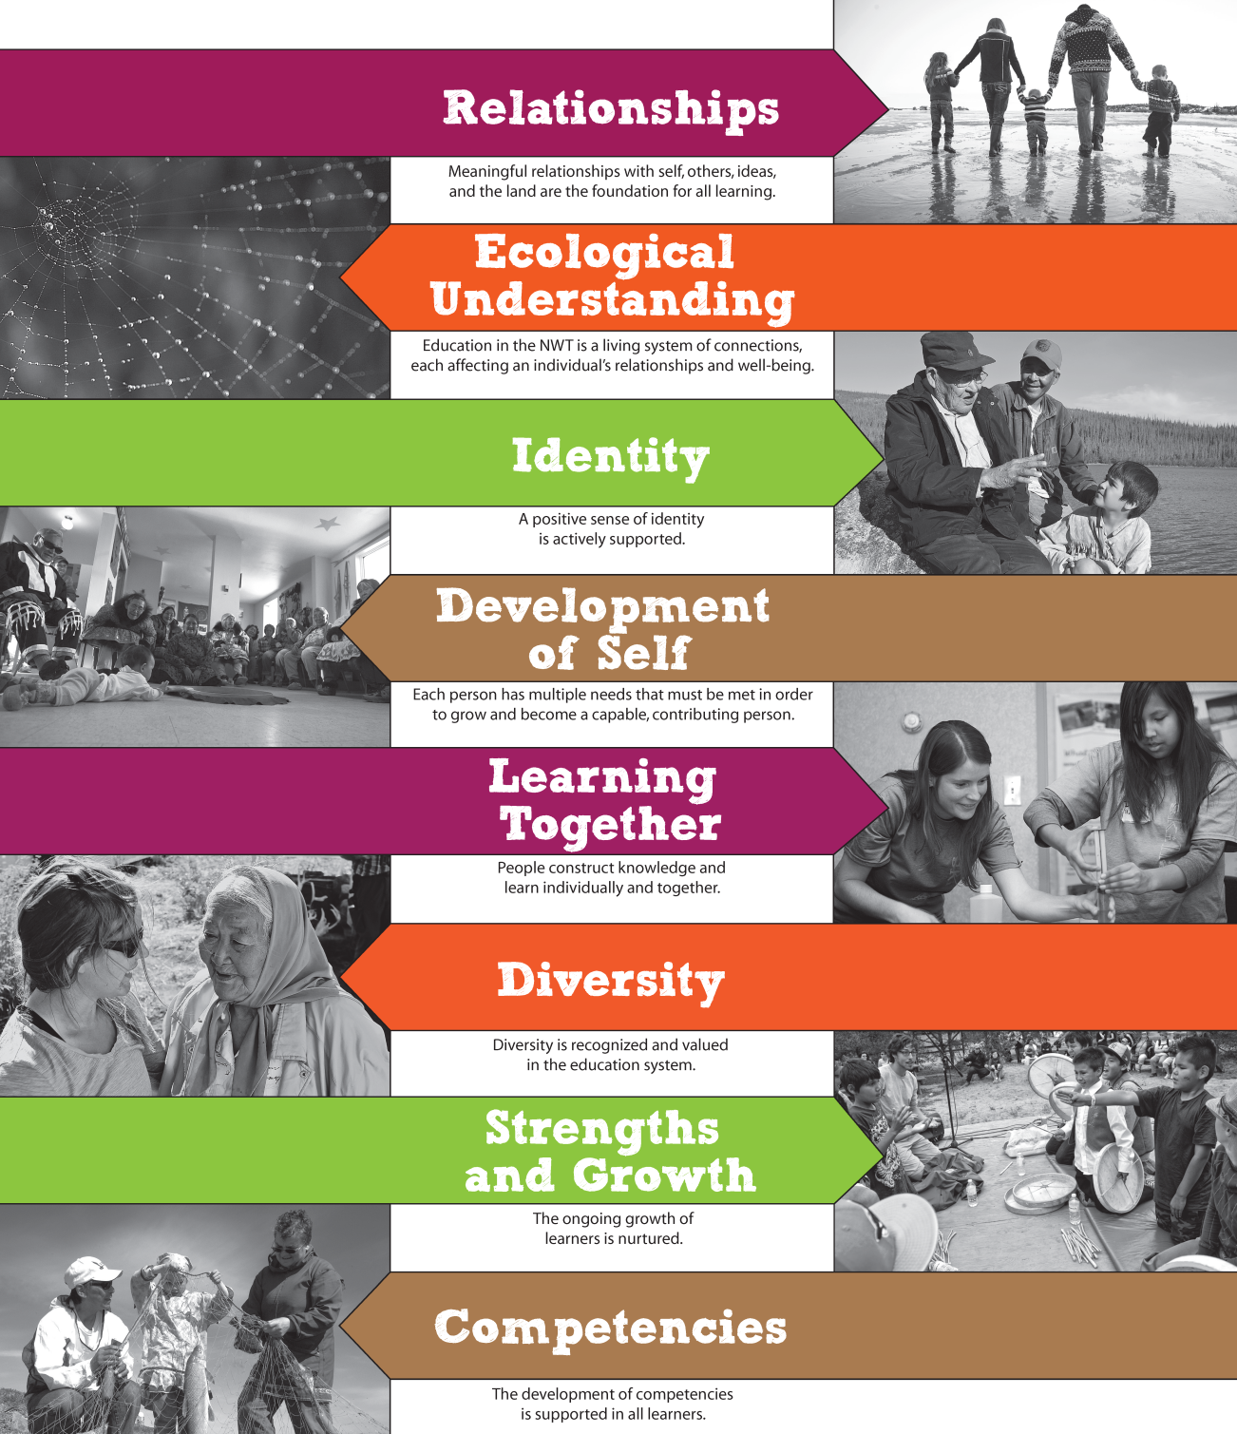
Foundational
Statements: the filter for our work
Notes:
Our next move was to establish Foundational Statements – or guiding principles, of sorts – to ensure that we stay true to what research and the people of the NWT told us.
These foundations grow out of ways of living and learning that have been understood in the North forever, and are being confirmed by both brain research and the best educational ideas from around the world.
They speak of:
the richness of our diversity and connectedness,
the importance of collaboration,
the centrality of identity and good relationships and
the need for all of us to see others, and ourselves, through strength-based glasses as we are all on our own continuum of growth
These are the principles that you will see behind all initiatives and work in education renewal, as we strive to ensure that all of our students receive the most relevant and effective education possible.

Slide 17
Education Renewal ~ the Initiatives
Strengthening Relationships
Indigenous Language & Culture Based Education (Indigenous language instruction pilot)
Elders in Schools program
Legacy of residential schooling
Fostering the Wellbeing of Student & Teachers
Resiliency Programming Self-Regulation Complex Needs Healthy Foods Safe and Caring Schools
Mental Health
Supporting the best teaching & learning
Inclusive Learning Supporting Northern Professionals Rethinking High school Pathways and Graduation NWT Distance Learning NWT Key Competencies Assessment, Evaluation & Reporting
Making Sure We’re on the Right Track
Wellness Information and Data MEA Planning Education Funding Framework
Notes:
The first initiatives or projects chosen to pave the way for change in education in the NWT were carefully chosen to support what we gleaned from research, the experience of Northerners and the guiding principles we established.
They can be organized under four areas of focus.
Strengthening Relationships
Funding to facilitate the presence of Elders in all NWT schools
Awareness training and curriculum development around the legacy of residential schooling
A policy in support of Aboriginal Culture Based Education
2. Fostering the Wellbeing of Students and Teachers – It has become very clear that unless we attend to all the “parts” of our students…unless they are well…they cannot do their best learning. This is why a number of our initiatives are focused on wellness.
A pilot program for resiliency development in at risk students
The implementation of self-regulation in schools across the NWT
The provision of funding for healthy snacks and meals in all NWT schools
3. Supporting the best teaching and learning
Identifying the key competencies of Northern people, students, to help focus our programming, teaching, assessment…
Rethinking high school pathways and graduation requirements
Developing a northern distance learning platform
Offering ongoing training and professional development to our educators in areas such as mindfulness and inclusive education, and finding ways to provide the time for professional activities like PD, data collection and analysis, expertise sharing, and collaboration
4. Making Sure We’re on the Right Track
Collecting the right data, both around academics and health indicators
Monitoring and adjusting our pilots and projects before expanding to make sure we’re making best use of public funds – and having the courage to stop those things that aren’t working

Slide 18
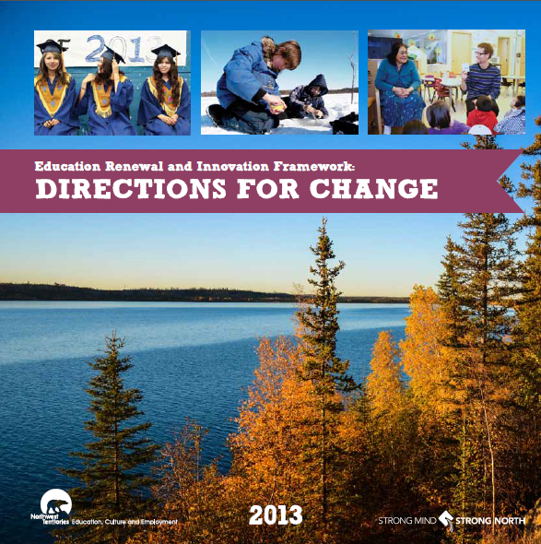
Taking steady, sustainable, measured steps
We are in the early stages of this exciting time of change.
We are beginning year 4 of a ten-year improvement process.
There are more ideas and initiatives to come, and the ones currently in play are being shaped by each year of implementation.
Notes:
We are in the early stages of this exciting time of change.
We are beginning year 4 of a ten-year process. I encourage you to dig into Directions for Change which you will have received in your packages. It provides much of the current educational context and provides a good picture of where we are all heading together.
There are more ideas and initiatives to come.
There will be opportunities to get involved and share your thoughts.

Slide 19
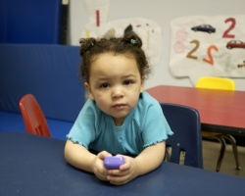
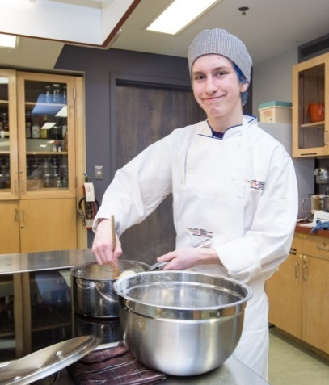
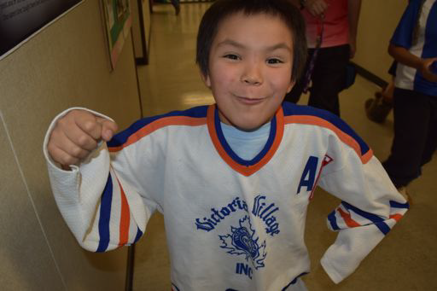
You and Your Students
What does that student look like?
How does he/she sound and behave?
How does that student feel first thing in the morning in your classroom?
What is on that student’s mind?
What does that student wish you would discover about him/her?
What really makes that student tick?
What does he/she need to feel and hear from you in order to really soar this year?
Notes:
All good stuff, but in a few days, you will be standing in front of a group of students.
Many will see & experience new and strange things in the days to come… understand that you’re the new comer, open-minded, open to learning…
Reach under your chairs, grab the piece of paper stuck under there, and read about a student who you might meet in your classroom, or school, in the days ahead. (CLICK)
What does that student look like? (CLICK)
How does he/she sound and act? (CLICK)
How might that student feel first thing in the morning in your classroom? (CLICK)
What might be on their mind? (CLICK)
What does that student wish you would discover about him/her? (CLICK)
What does that student need to hear from you in order to soar this year? (CLICK)
You have the opportunity, the responsibility, to see the gift in each parent, co-worker and especially student this year.
Understand the influence you have, the weight of your responsibility…the opportunity…
I wish you a wonderful school year. We are so very happy you have decided to teach here.
…

