Slide 1
Education, Culture & Employment: Instruction & School Services (ISS): Curriculum
Blake Wile , Aug. 15, 2017

Slide 2
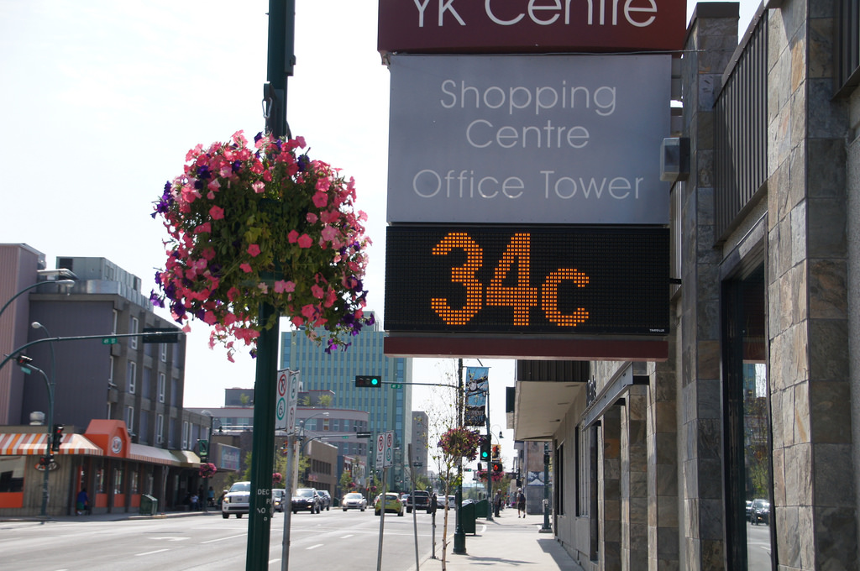
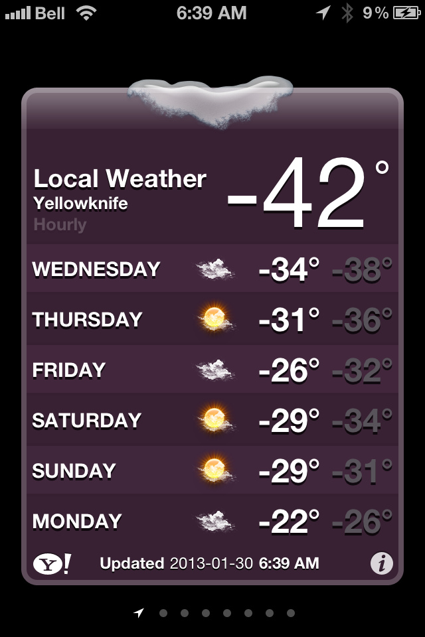
Welcome to Yellowknife!

Slide 3
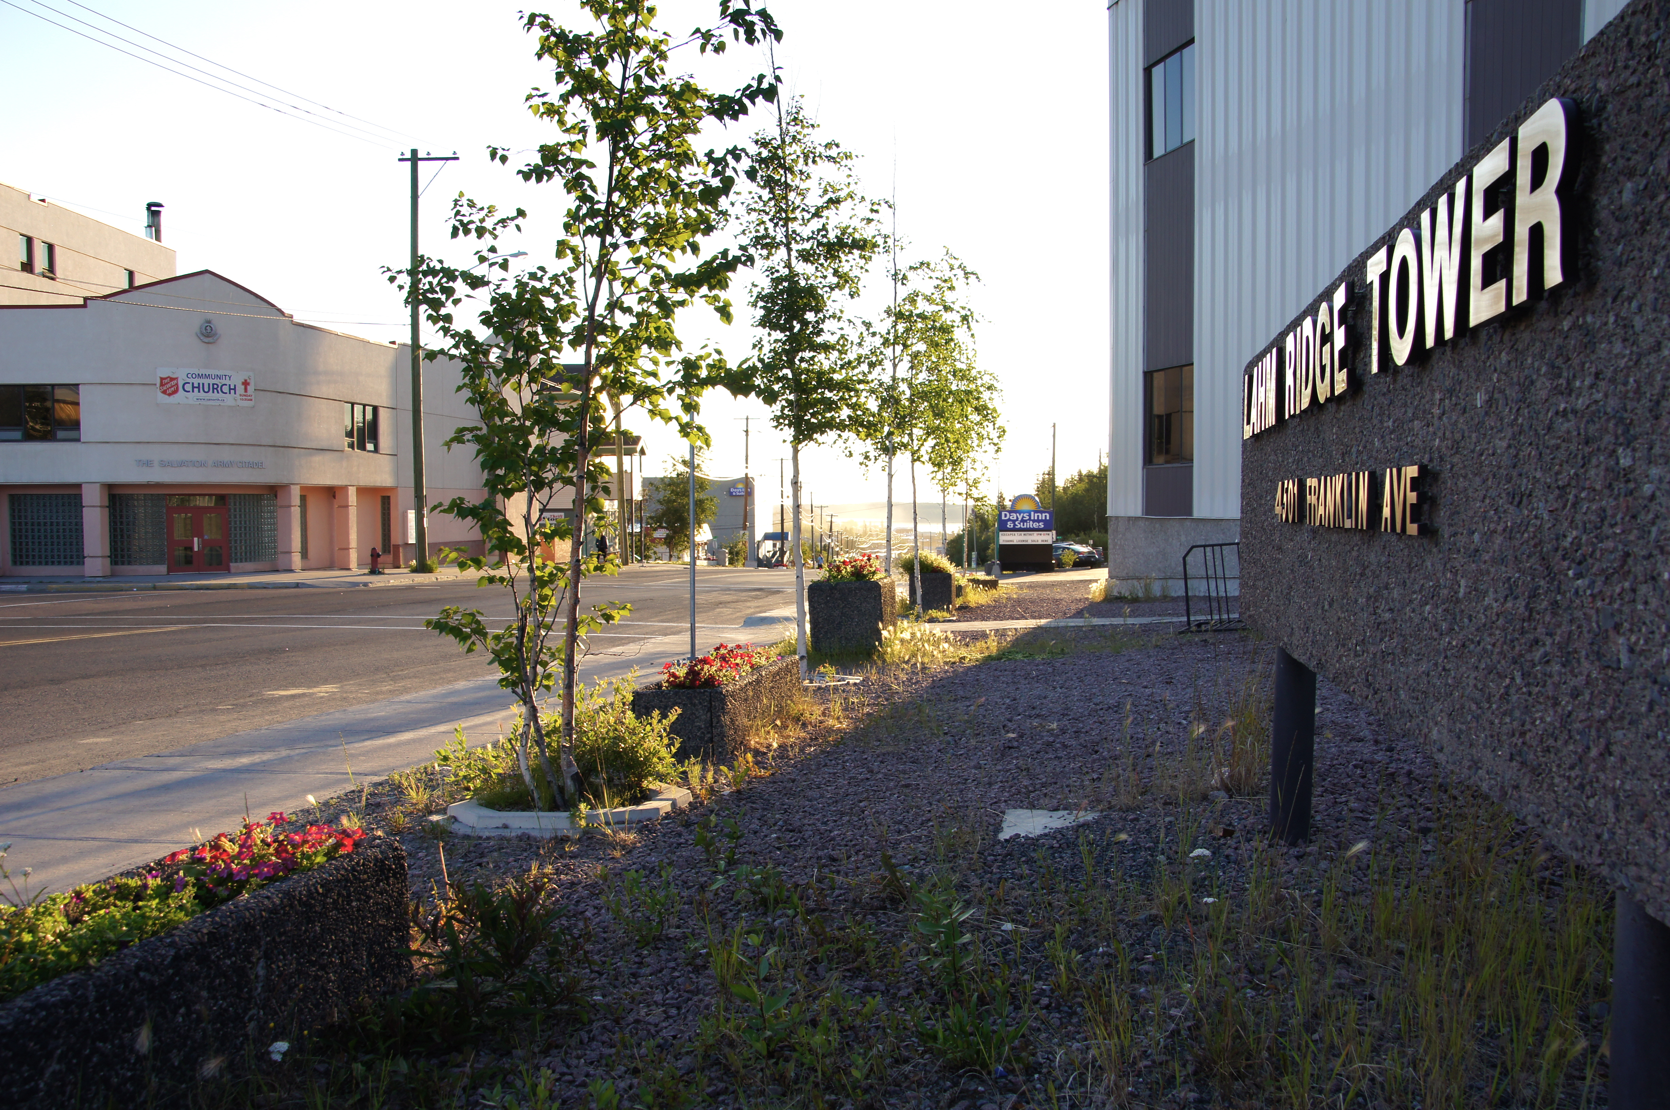
Curriculum Coordinators - Yellowknife
10-12 staff
(former school-based educators)
Yellowknife
(Lahm Ridge Tower)
In-servicing
(Regional on invitation;
Online; always through board curr. leaders)

Slide 4
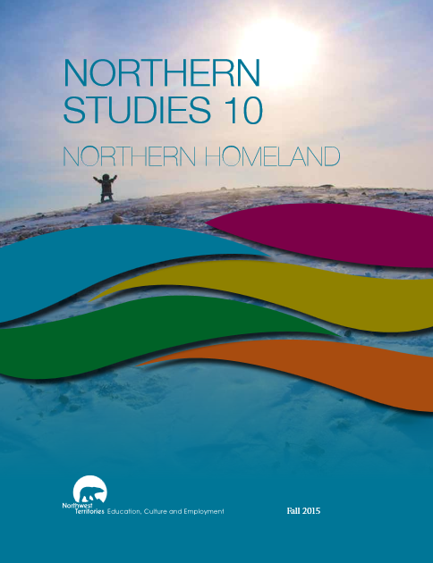
What is Curriculum?
Etymology
("a running, course, career"
also, "a fast chariot, racing car”)
Modern
(content of one course, sum of all course offerings, etc.)
“Planned” & “Lived”
The good life
(in various NWT contexts)

Slide 5
Approaches
Adopt
(as is)
Adapt
(edit, annotate, portions)
Original
(from scratch)
Image by derekbruff under a some rights reserved license

Slide 6
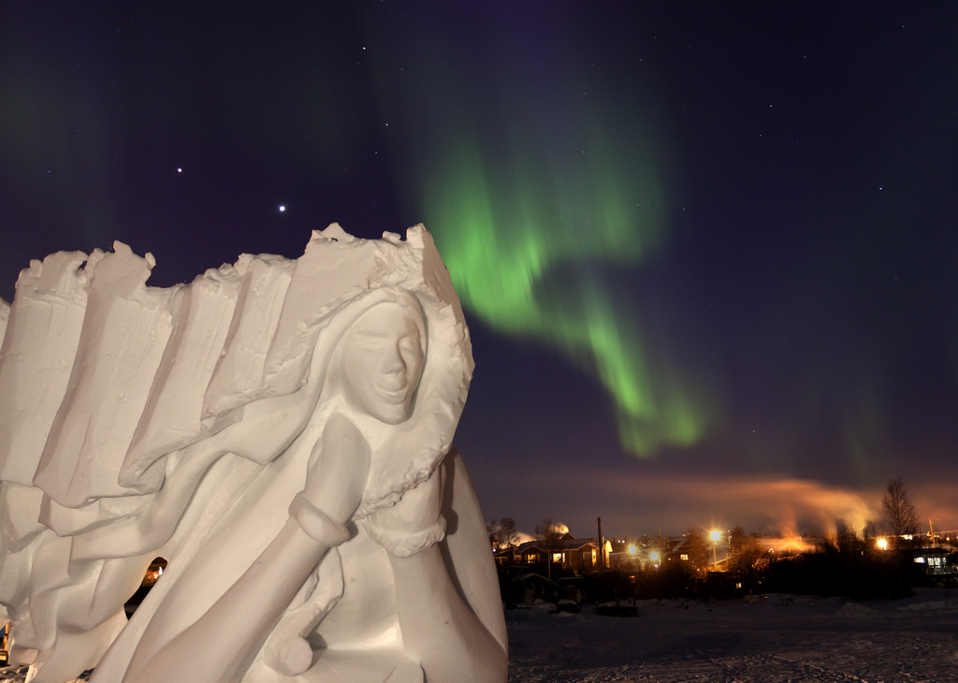
Influences
Geography
(north of Alberta)
Demographics
(governments/populations shaped by Indigenous peoples)
Memberships
(WNCP)
Image by useless no more under a some rights reserved license

Slide 7
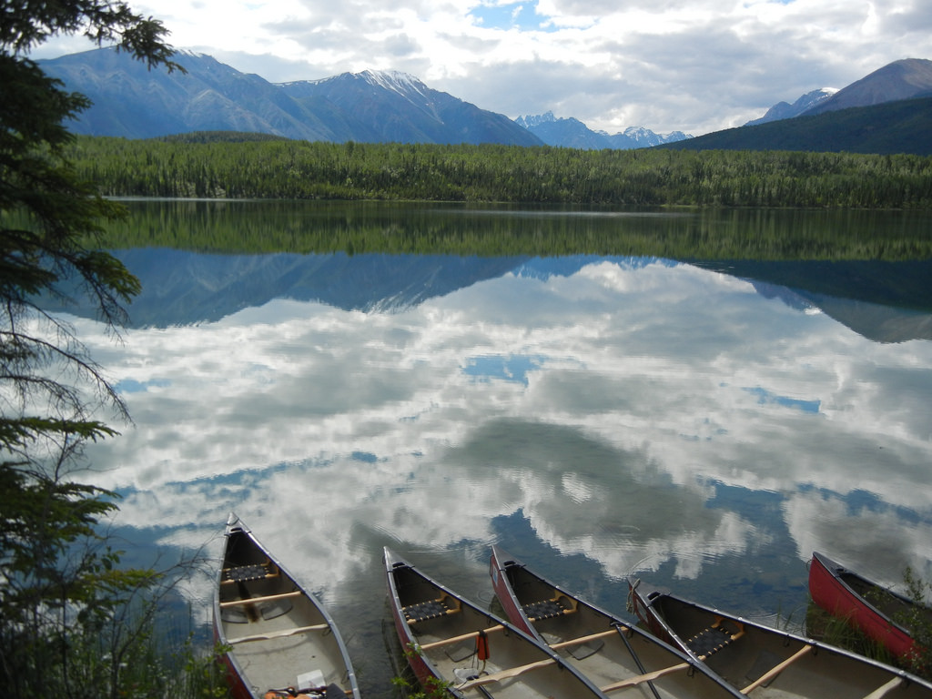
Curriculum Sources
Alberta
(esp. high school courses)
Manitoba
(esp. elementary Social Studies)
NWT
(esp. Northern Studies, Health, Experiential Science, ELA K-9, Literacy 10, 20, 30, Dene Kede, Inuuqatigiit)
Saskatchewan
(Arts Education 1-9)
Image by hatchard under a some rights reserved license

Slide 8
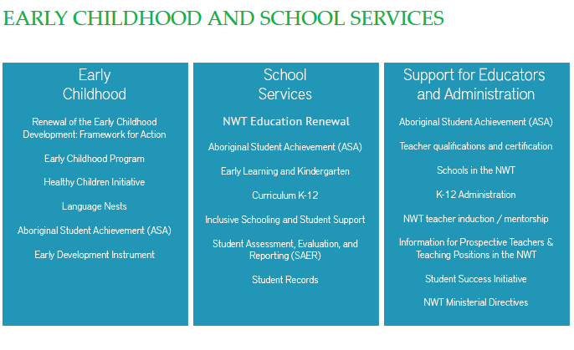
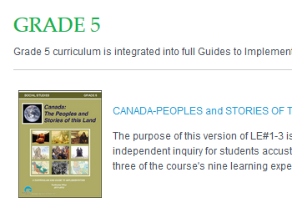
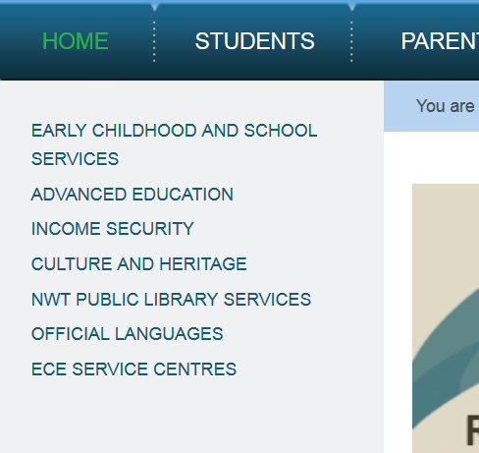
Curriculum Online
ECE website
(5 years old)
Audience/user oriented
(out of step with other GNWT depts.)
www.ece.gov.nt.ca
(organized loosely by divisions)
French Schs & Immer.
(raymonde_laberge@gov.nt.ca)

Slide 9
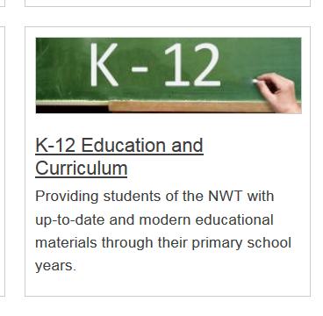
Curriculum Online
New ECE website
(coming in September according to VIP standards)
Standardized:
(services-oriented)

Slide 10
Education Renewal > Curriculum
Curricular Framework
(under development)
Health & Wellness Curriculum
(under development)
Other curricula impacted
(Northern Studies 20, PK-Kindergarten, Aboriginal Language)

