Slide 1
Introduction to Powerschool Gradebook and tienet

Slide 2
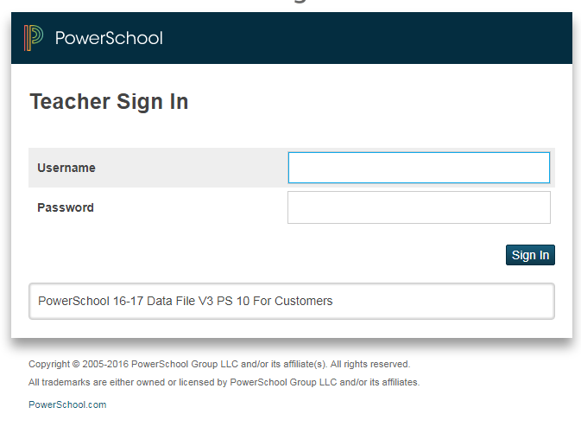
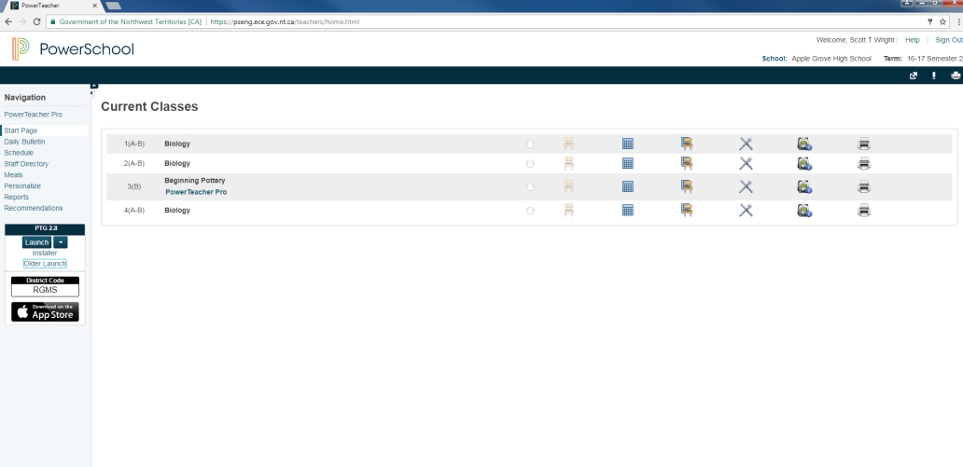
Powerschool SIGN IN
Enter your username and password to login to PowerSchool.
Once you have signed in, you will see a list of all your current classes.

Slide 3
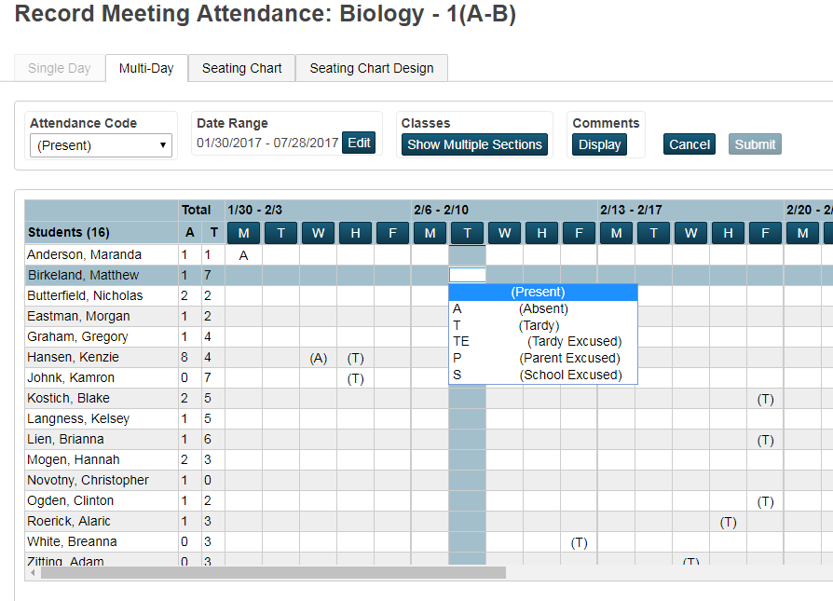
Powerschool- Attendance
To record attendance for a class, you select the chair icon for today’s attendance.
Alternately, you can select the calendar icon
for multi-day attendance.
By selecting a date for a specific student in a class, you can select an option from the menu.

Slide 4
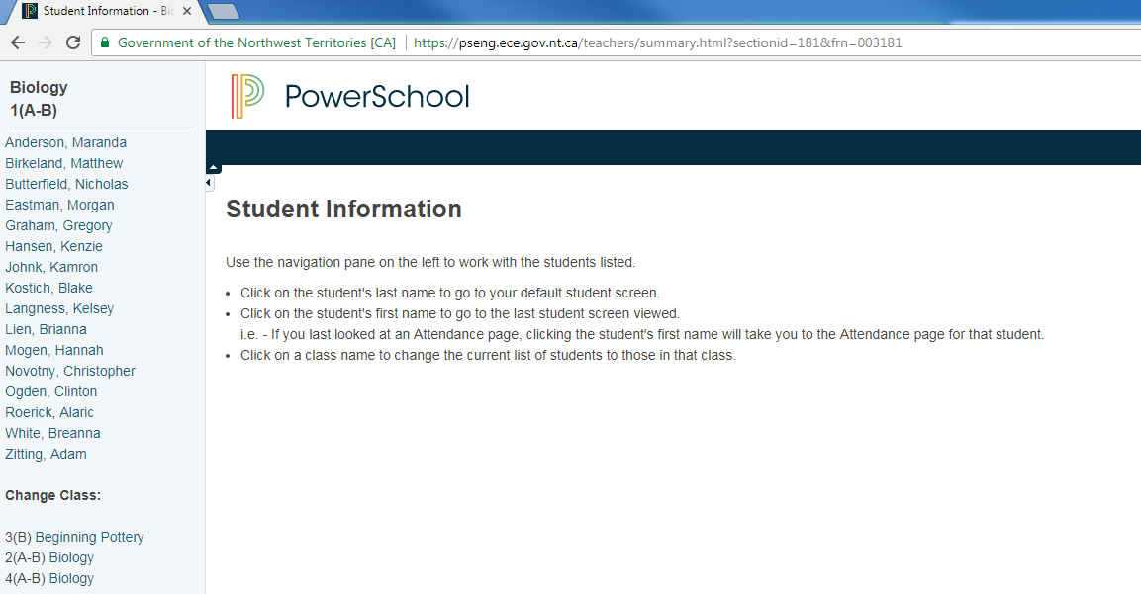
Powerschool-Student information
By clicking on the Student Information icon f from the main PowerSchool menu, you can access information about a student, such as their course schedule or guardian contact information.
From this screen,
select a student’s
name.

Slide 5
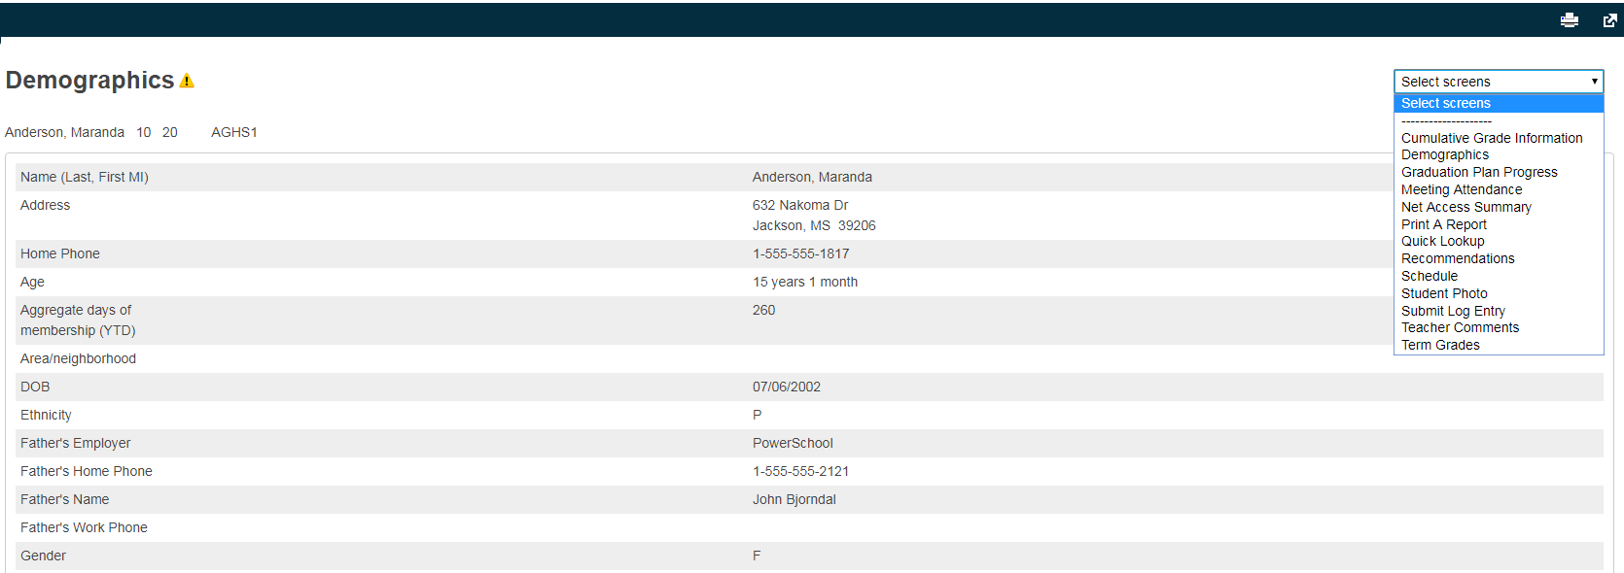
Powerschool-Student information
By selecting an option from the drop-down menu located on the top right, you can access various information about a particular student.

Slide 6
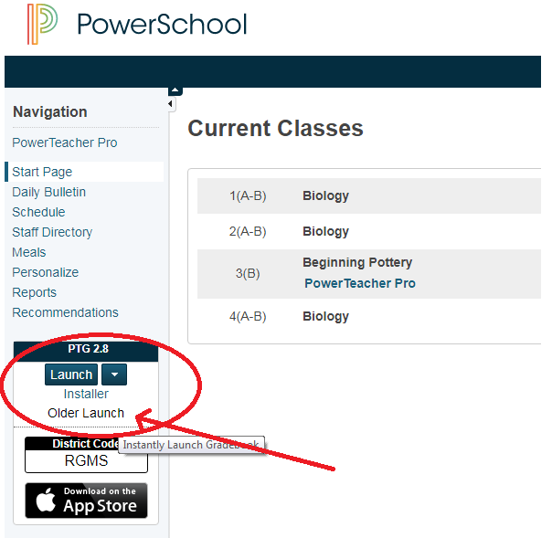
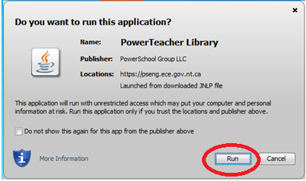
Gradebook-Launch
To Launch PowerTeacher Gradebook, click on the arrow next to Launch, and select Older Launch
Select “Run” when asked if you want to run the application.

Slide 7
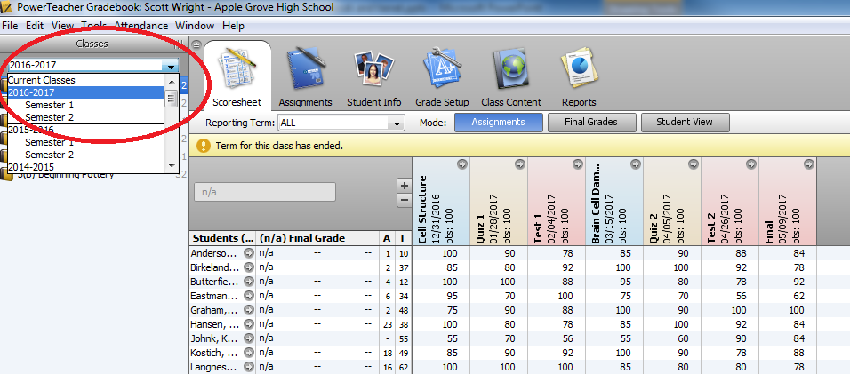
Gradebook-Select Class
From the drop down menu located at the top left corner, select the right year and semester.
Select the class you want to work with.

Slide 8
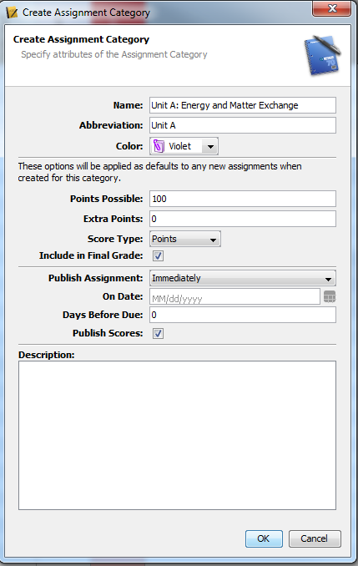
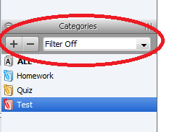
Gradebook-creating categories
To create a category, select the + button in the Categories section at the bottom left corner of the screen.
Fill in the details of the category you would like to create. Generally, categories refer to units of study, or types of evaluations. Categories are generally created to reflect your course outline.

Slide 9
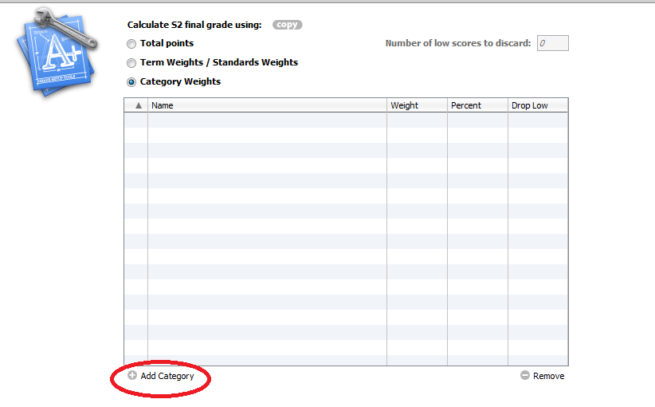
Gradebook-weighing categories
You will need to weigh categories according to your course outline. From the tabs at the top of the screen, select Grade Setup
Select the reporting term.
From the 3 options, select category weights.

Slide 10
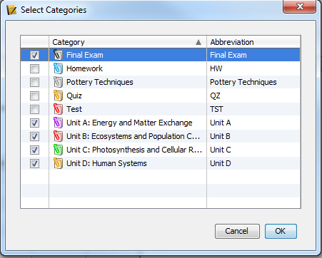
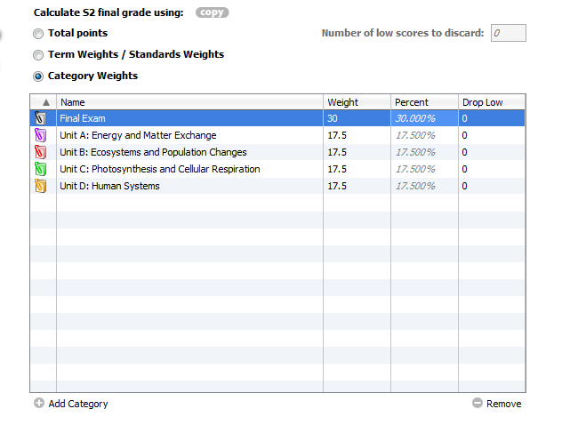
Gradebook-Weighing Categories
To add categories to your class, select all categories that apply and select ok.
Enter weights for each of the categories. These usually correspond to a percentage of the final mark (according to your course outline). Save.
Tip: Do this at the start of the semester for all your classes. If you do not set this up, Gradebook will not be able to calculate a class mark.

Slide 11
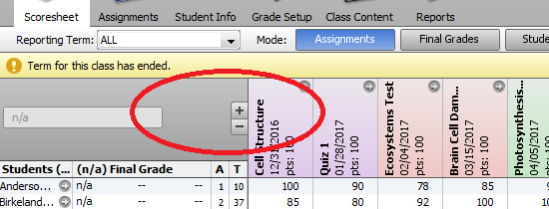
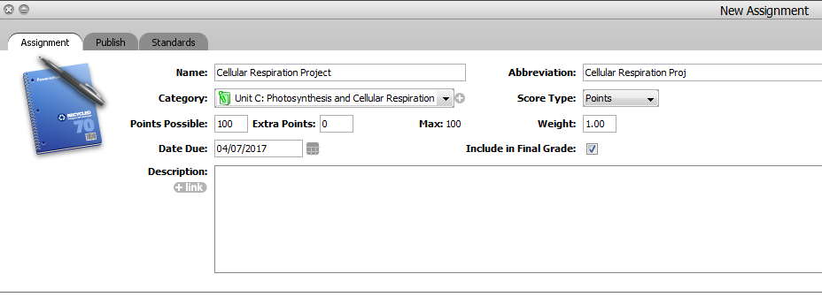
Gradebook-Creating a new assignment
To create a new assignment for a class, select the + sign above your student list. This will create a box at the bottom of your screen for your new assignment. Give a relevant name to the assignment, then select the appropriate category, due date and points possible. Save.

Slide 12
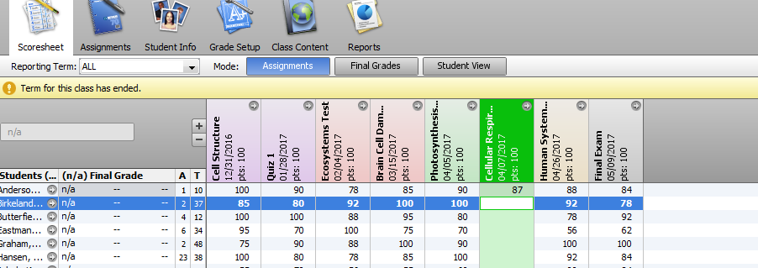
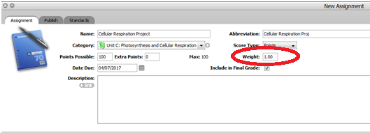
Grade-book-Entering grades
Once you have created your new assignment, you can enter students’ grades by clicking on the cell. Don’t forget to save often!
You can also weigh assignments within a category. This can be useful if you want an assignment to be worth more than another within that category (i.e. test or quiz). This can be done by double clicking on the assignment name and changing the weight.

Slide 13
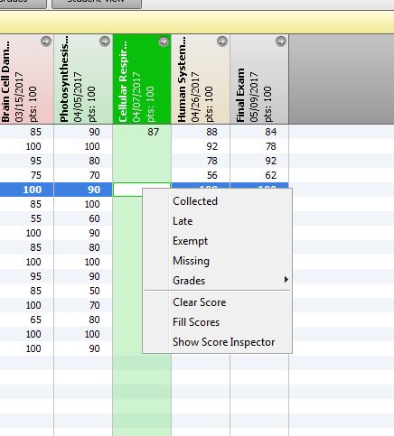
Gradebook-Missing or late assignments
If you would like to keep track of missing or late assignments, you can do so by right-clicking on the cell where you would normally enter a student’s grade. This is particularly useful to generate a list of outstanding assignments.
Similarly, you can also use this feature to indicate that you have collected an assignment.

Slide 14
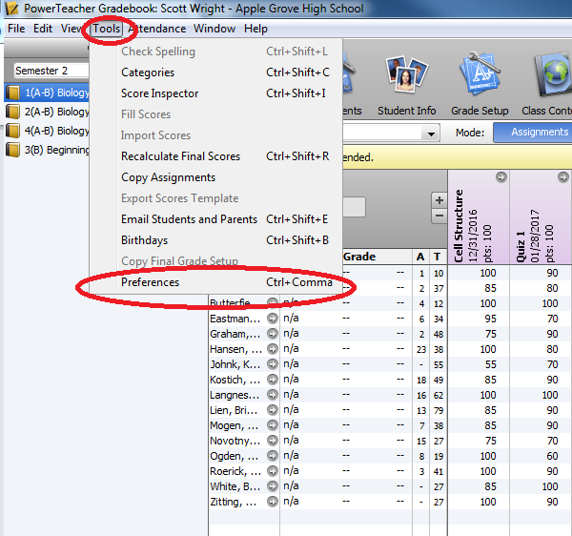
Gradebook- comments and Reports
You will be using gradebook for report card writing. It is also very useful to produce informal progress reports to share with students and parents. PowerTeacher gradebook calculates students’ grades automatically, using the weightings you have entered for categories and assignments. However, you should be able to explain how a final mark was obtained and how to calculate it manually.
You can create a comment bank, which can be used as a class comment or for comments you use often. To create a comment, from the Tools menu, select Preferences

Slide 15
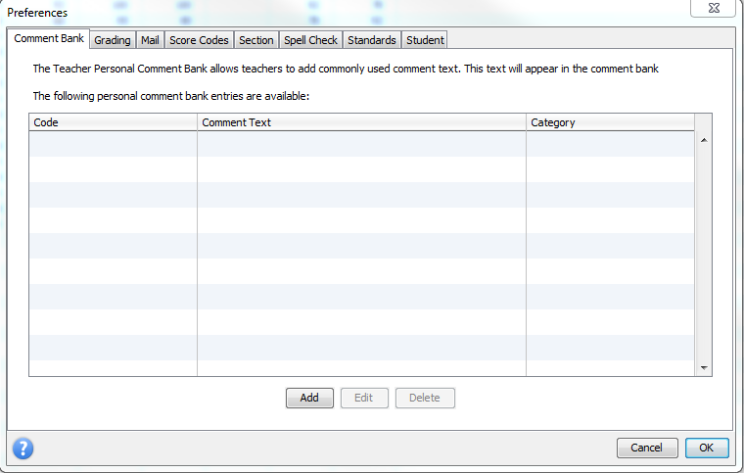
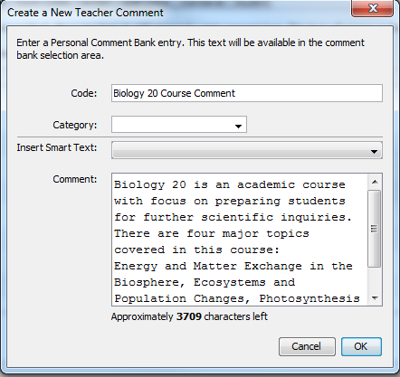
Gradebook-Comments and reports
In the first tab labeled Comment Bank, select the Add button.
Enter a code for your comment. This acts as a title for your comment, so you can find it again later.
Enter the comment category. You will usually have a choice between class comment or student comment.
Enter your comment and select OK. This will save the comment for future use.

Slide 16
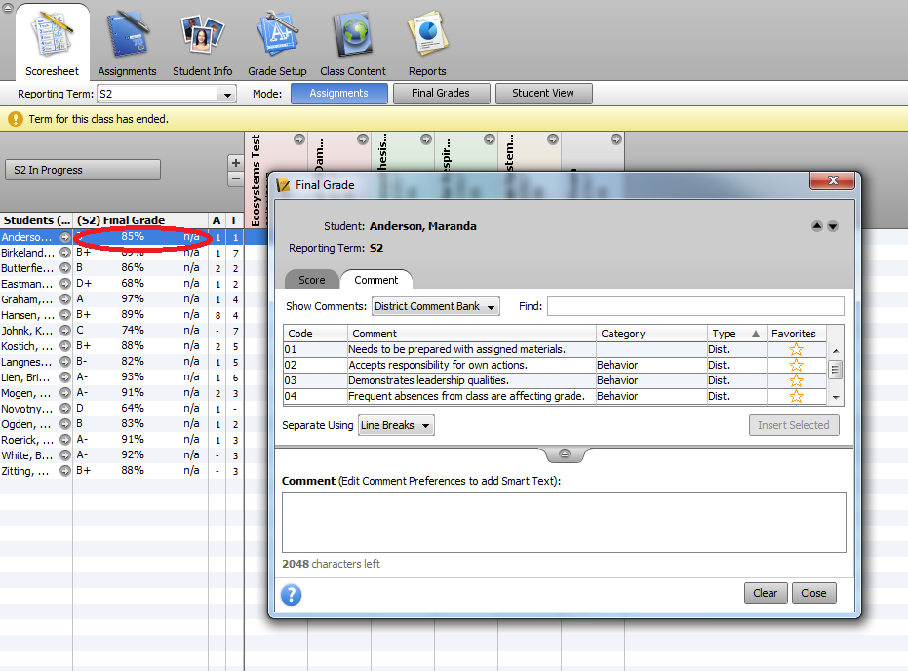
Gradebook-Comments and Reports
To add a comment to a student’s report card or progress report, double click on the box next to the student’s name under the Final Grade column. You will then have access to your banked comments, or you can write personal comments in this section as well.
Your school will indicate their preferred format for report card comments, usually a combination of course comments and personal comments about a student’s progress.

Slide 17
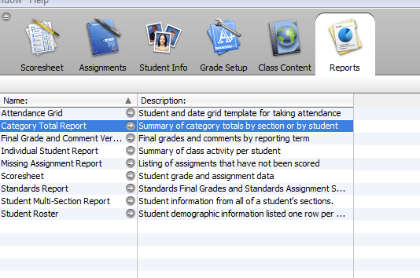
Gradebook-Reports
You can generate multiple types of reports with gradebook. Under the Reports tab, you can choose the type of report you would like to create, such as Individual Student Report, or Missing Assignment Report. You can also print off attendance grids.

Slide 18
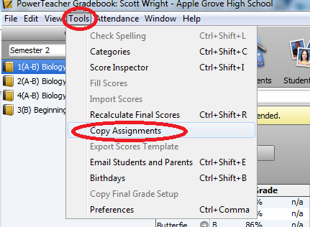
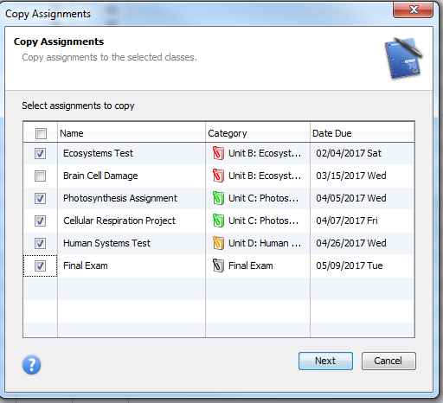
Gradebook- Copying ASSignments
This tool is particularly useful if you teach the same course from one semester to another or from one year to the next.
Categories will remain in your Gradebook account, so you will not have to recreate these, however you will have to set up your Grade Setup for each class at the start of each new term. If you are teaching multiple sections of the same course, it is also possible to copy assignments from one class to another.
From the Tools menu, select Copy Assignments. Select the assignments you would like to copy, then click on “Next”

Slide 19
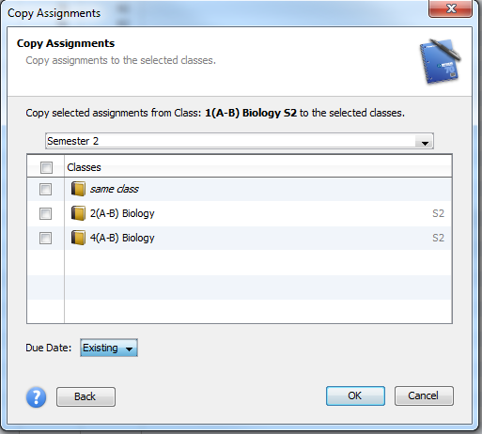
Gradebook-copying assignments
Select the year and semester and class where you would like to copy the assignments and click “OK”. You will likely have to change some information, such as due dates, etc.

Slide 20
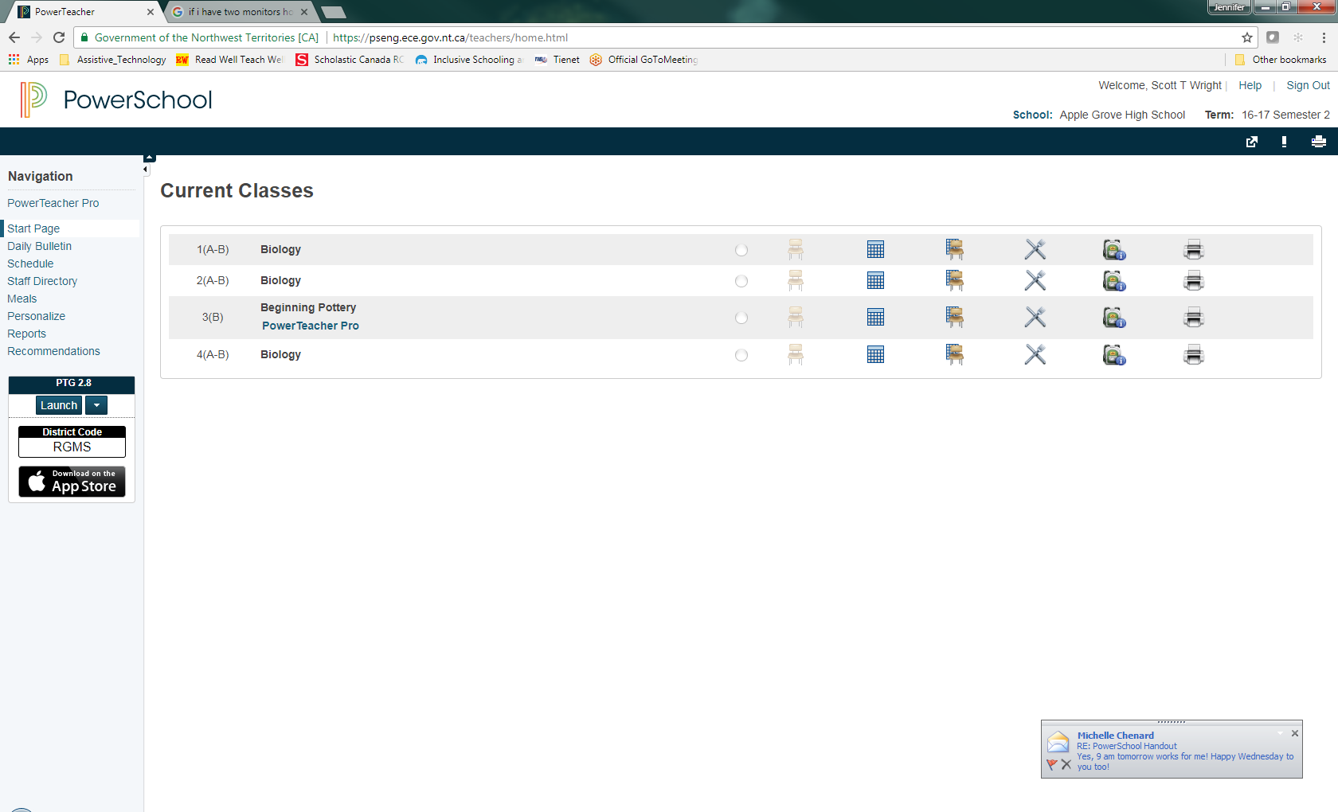
Accessing Tienet
From the Start Page in PowerSchool – click on the arrow in a box to access TieNet.

Slide 21
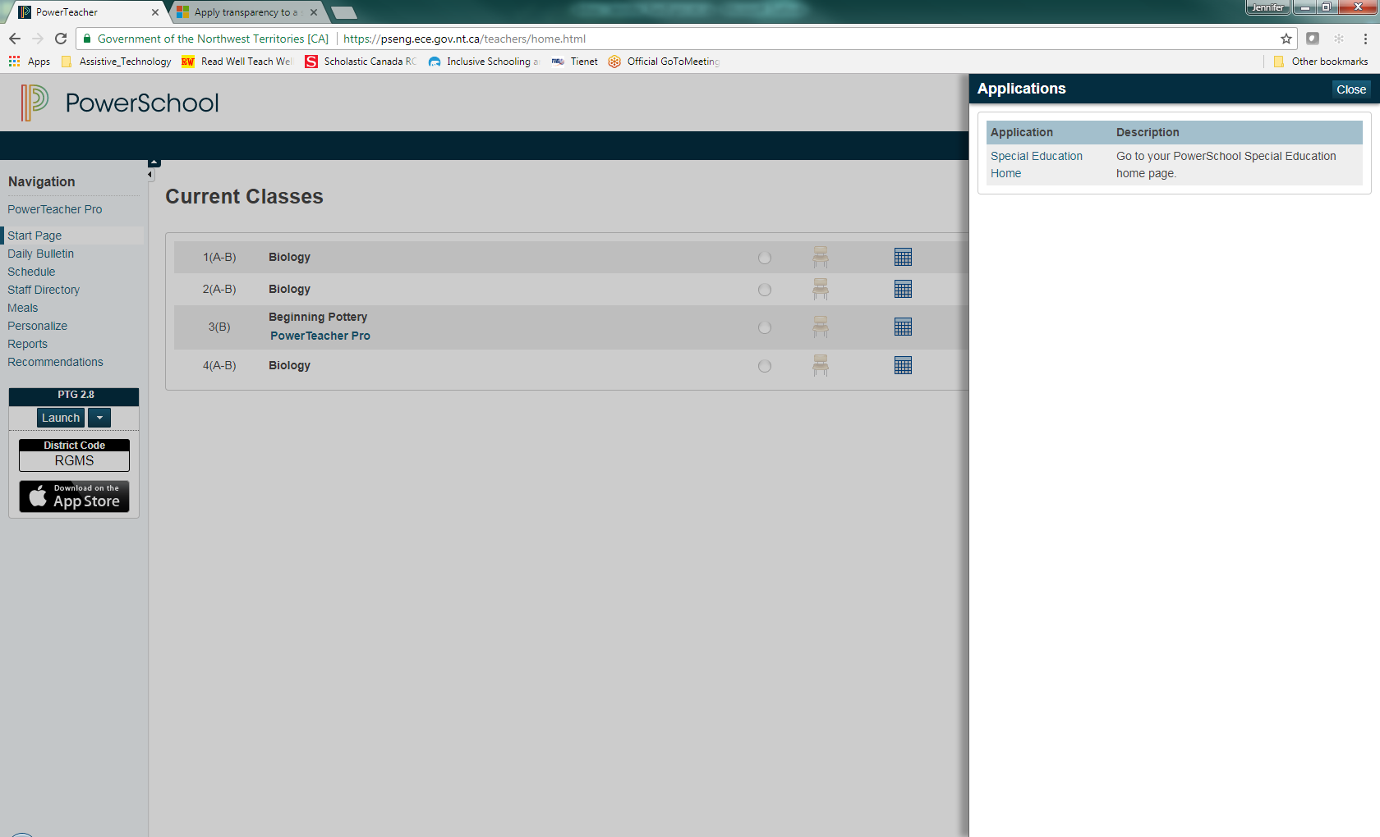
Accessing Tienet
Click on “Special Education Home”

Slide 22
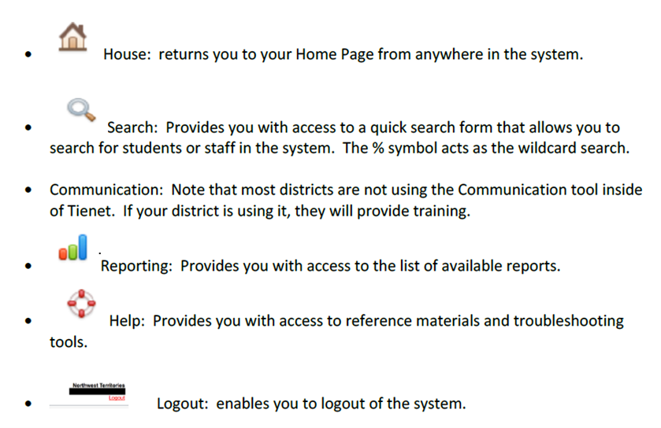
Tienet Homepage
You are now on the TieNet Homepage
You may click on the underlined words or icons on the navigation bar to move to different sections.

Slide 23
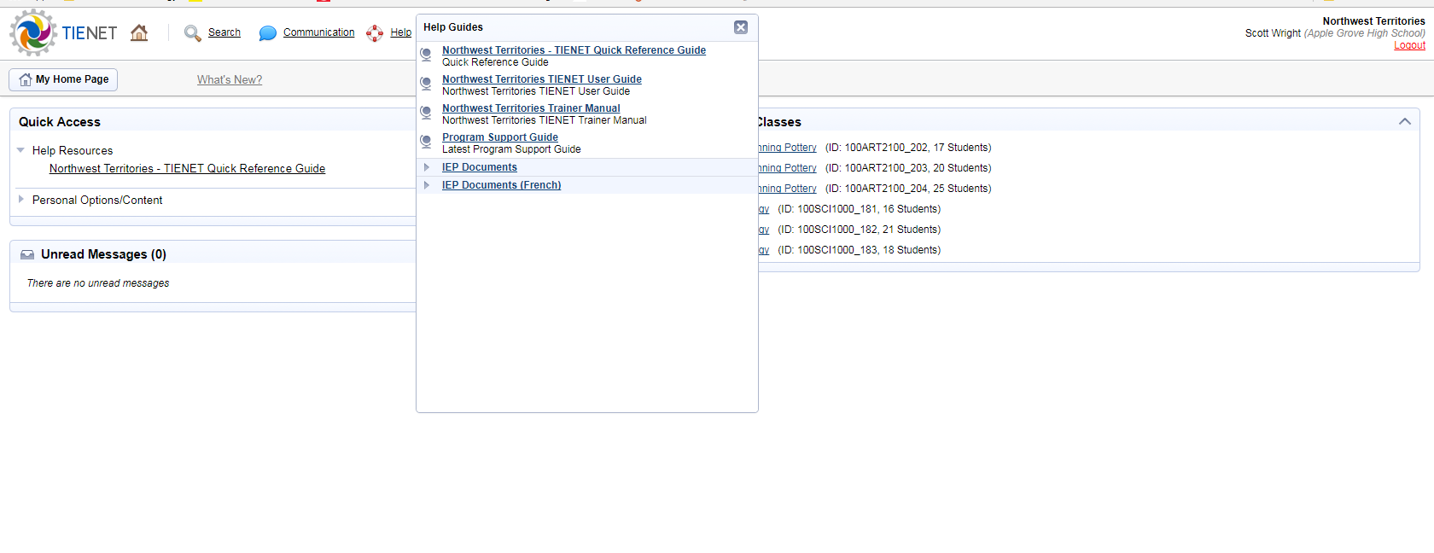
Quick Help Guides
Click on Help Resources to access TieNet Quick Reference Guide
Click on Help on the Navigation Bar for more resources.

Slide 24
Accessing Student roster
Click on the class name to access the student roster.

Slide 25
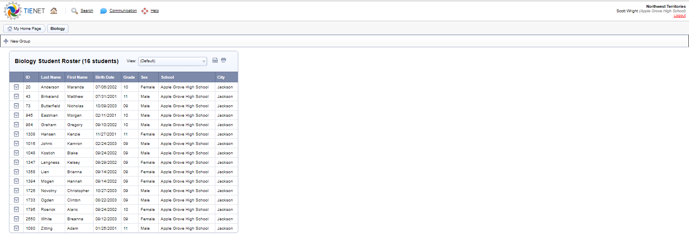
Student Roster page
Student Roster - can see all student enrolled in that class

Slide 26
Student Roster – Program Type
Click on view
Select “program type” to view education programs by student roster

Slide 27
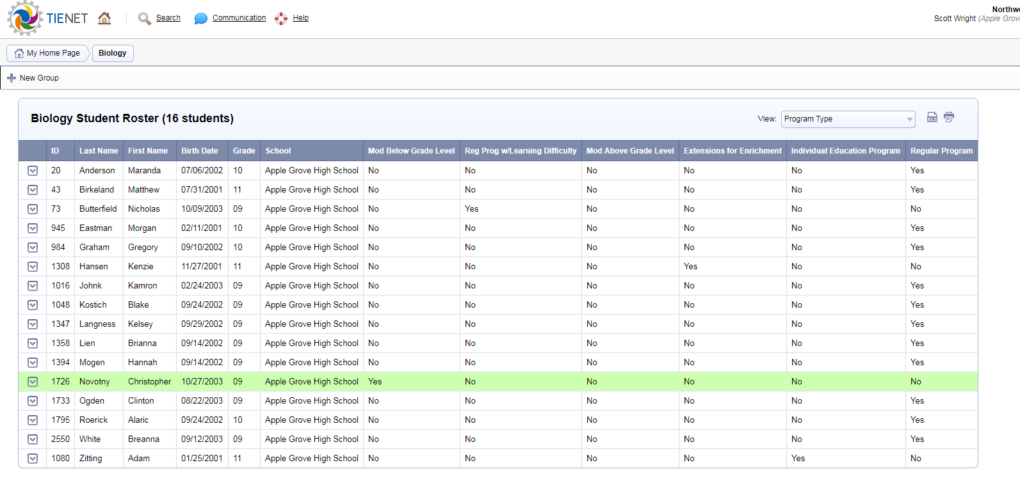
Program Type Page
Education Programs are across the top of the chart
MEP SSP MEP SSP IEP

Slide 28
Accessing Student Profile Page
On the student roster page:
click on the “arrow” next to the student’s name to access:
Student Profile
Documents

Slide 29
Student Profile Page
Student Demographics – info is pulled from PowerSchool
Tabs along the top – can access Documents and Events.
Click on General Demographics – to access Program Information

Slide 30
Program information page
Program Type:
SSP, MEP, IEP
Assessment/Support Services
Support Services (SLP/OT/Audiology)
Assessments in Student Support File

Slide 31
Documents Page
Documents for student from previous/current year.
Hard copy of documents are in Student Support File (yellow folder)

Slide 32
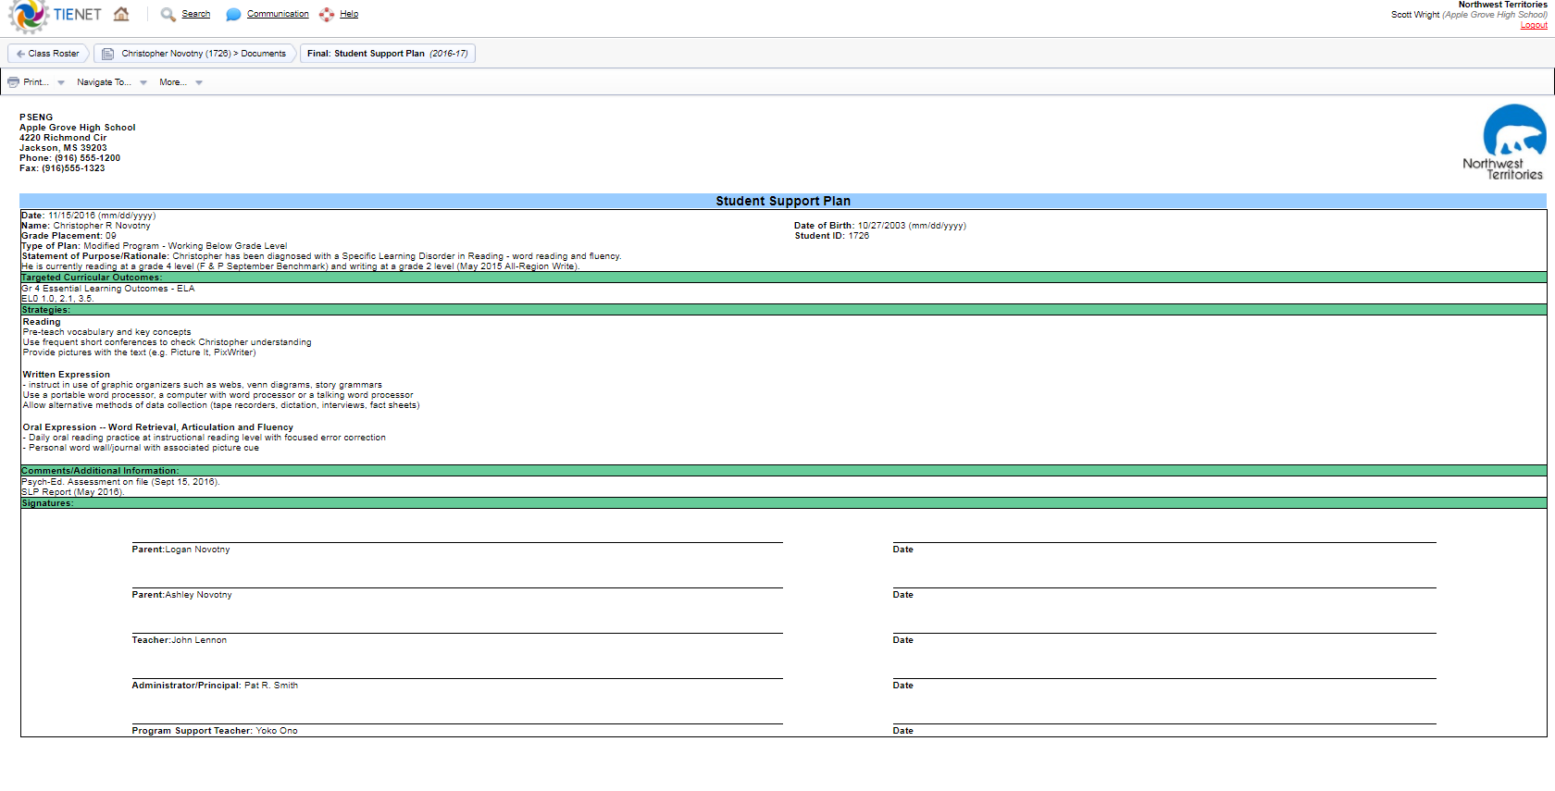
Student Support Plan
Example of Student Support Plan (Modified) – can print, revise, and view file attachments from this page.

Slide 33
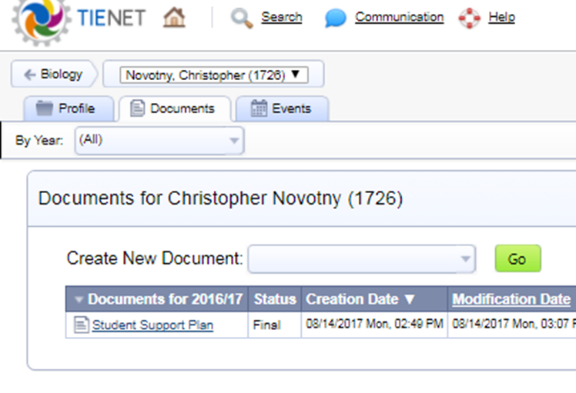
Creating a New Document
On Documents page – click on Create New Document
Contact your PST before creating any documents in TieNet
Click green “GO” button to create a document & then “NEW”

Slide 34
Adding Info To SSP template
You can now start to add information to a Student Support Plan (Regular program with accommodations).
DO NOT create documents without the support of your PST – especially Modified Education Plans and Individual Education Plans (MEP & IEP should be developed after a decision is made by the SBST).

Slide 35
Events Page
Events – a log of changes to the documents on file
Can also add events – such as phone calls home, parent meetings, assessments, transfers, etc.

Slide 36
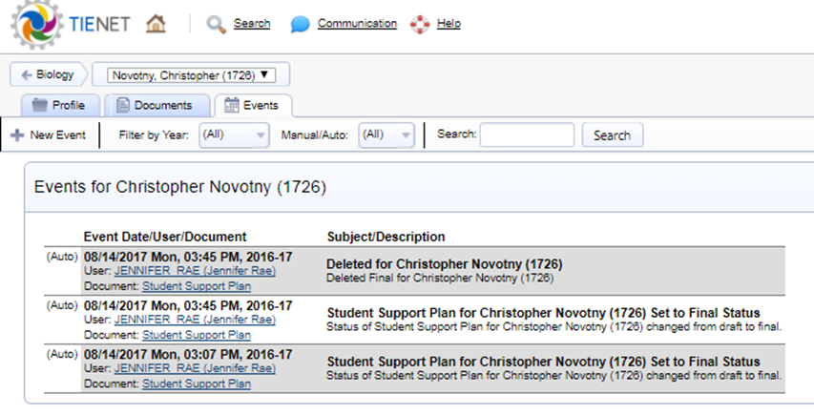
Adding a new event
Click on New Event
Add Description & Click Accept
Your event is now saved !

Slide 37
Questions/Concerns
This handout is intended as a “quick start” guide to PowerSchool and TieNet.
As you start to use this program – and have questions, please reach out to –
At the school level, ask your Principal and fellow teachers (PS/PT) and/or your Program Support Teacher (Tienet)
For further support with PS/PT, contact your Regional Tech Support Coordinator.
If you are a PST and need further support with Tienet, contact your Regional Inclusive Schooling Coordinator (RISC)

